Slide 1
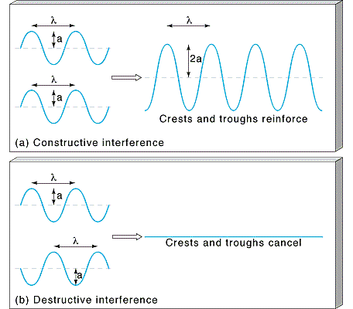
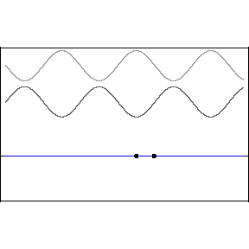
Interference
waves can interfere (add or cancel)
But one can play more complicated games:
http://www.falstad.com/fourier/

Slide 2
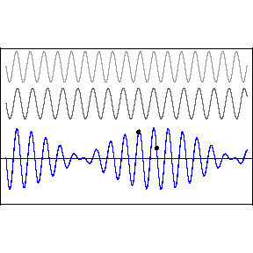
Interefering waves, generally…
“Beats” occur when you add two waves of slightly different frequency. They will interfere constructively in some areas and destructively in others.
Can be interpreted as a sinusoidal envelope:
Modulating a high frequency wave within the envelope:

Slide 3
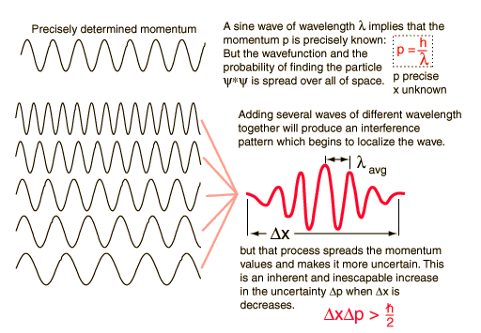
FOURIER THEOREM: any wave packet can be expressed as a superposition of an infinite number of harmonic waves
Adding several waves of different wavelengths together will produce an interference pattern which begins to localize the wave.
To form a pulse that is zero everywhere outside of a finite spatial range Dx requires adding together an infinite number of waves with continuously varying wavelengths and amplitudes.
adding varying amounts of an infinite number of waves
spatially localized wave group
sinusoidal expression for harmonics
amplitude of wave with wavenumber k=2p/l

Slide 4
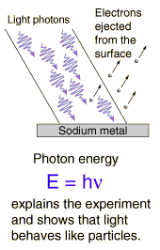
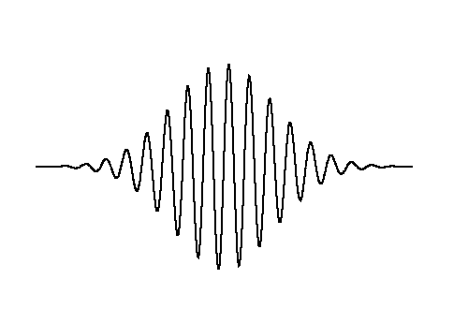

WAVE PACKETS
The word “particle” in the phrase “wave-particle duality” suggests that this wave is somewhat localized.
How do we describe this mathematically?
…or this
…or this

Slide 5
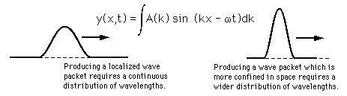
The Uncertainty Principle
Remember our sine wave that went on “forever”?
We knew its momentum very precisely, because the momentum is a function of the frequency, and the frequency was very well defined.
But what is the frequency of our localized wave packet? We had to add a bunch of waves of different frequencies to produce it.
Consequence: The more localized the wave packet, the less precisely defined the momentum.

Slide 6
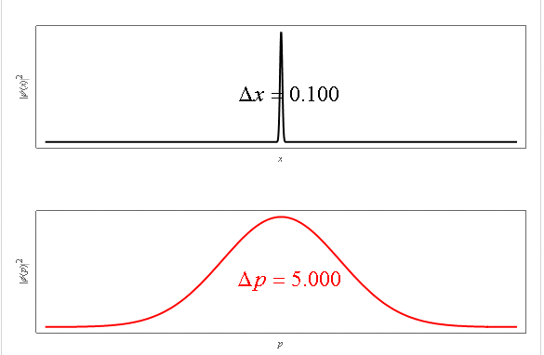
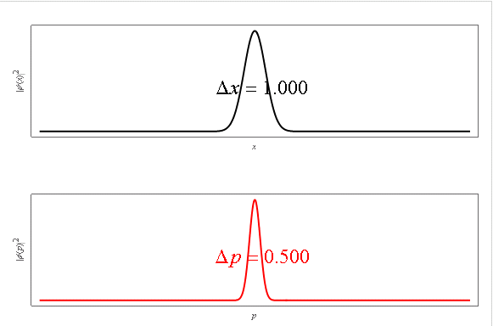
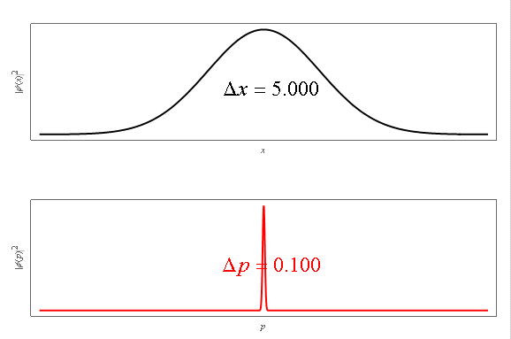
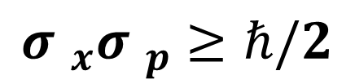
Uncertainty Relation for Gaussian Wavepackets
$${σ }_{x}{σ }_{p}≥ℏ/2$$
http://demonstrations.wolfram.com/EvolutionOfAGaussianWavePacket/

Slide 7
